Slide 1
Topics in Data Science
Classification
Lecture 10

Slide 2
Learning System Model
Testing
Input Samples
Learning Method
System
Training

Slide 3
Supervised Vs. Unsupervised Learning
  Machine learning is a category of artificial intelligence that includes a number of algorithmic approaches. In manufacturing, the 2 most common approaches are supervised and unsupervised learning.
  Supervised learning is the Data mining task of inferring a function from labeled training data. The training data consist of a set of training examples. In supervised learning, each example is a pair consisting of an input object (typically a vector) and a desired output value (also called the supervisory signal).
  Unsupervised learning is that of trying to find hidden structure in unlabeled data. Since the examples given to the learner are unlabeled, there is no error or reward signal to evaluate a potential solution.

Slide 4
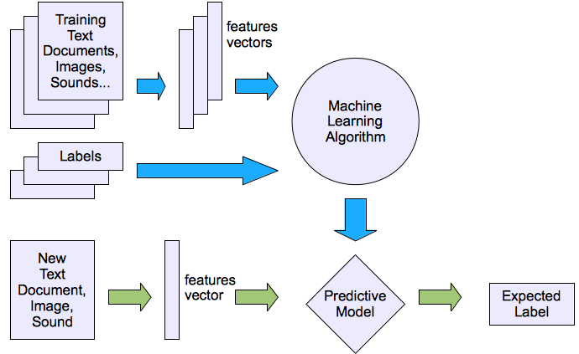
Machine Learning Structure
Supervised learning

Slide 5
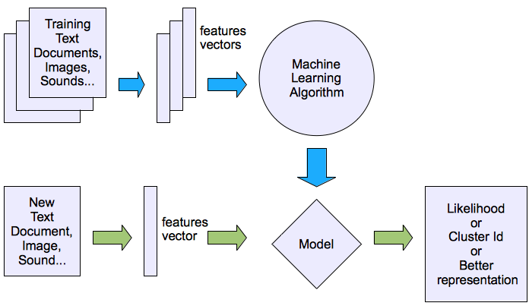
Machine Learning Structure
Unsupervised learning

Slide 6
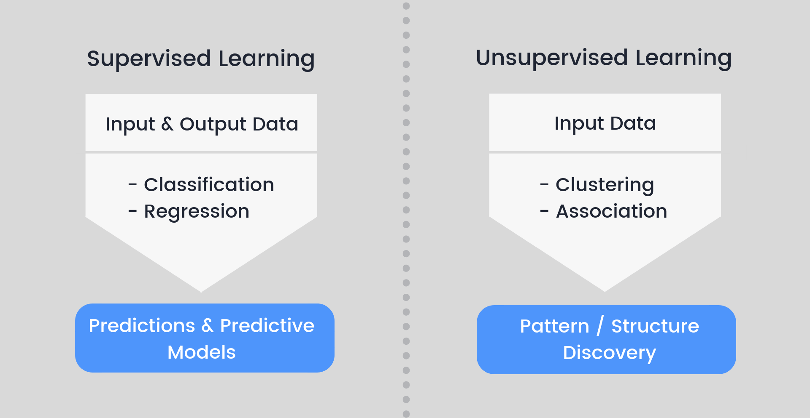
Supervised Vs. Unsupervised Learning

Slide 7
Classification & Prediction
There are two forms of data analysis that can be used for extracting models describing important classes or to predict future data trends.
  Classification
  Prediction (using Regression)
In general, classification models predict categorical class labels; and prediction models predict continuous valued functions.
Classification and Prediction Issues
The major issue is preparing the data for Classification and Prediction. Preparing the data involves:
Data Cleaning − Data cleaning involves removing the noise and treatment of missing values. The noise is removed by applying smoothing techniques and the problem of missing values is solved by replacing a missing value or
Relevance Analysis − Database may also have the irrelevant attributes. Correlation analysis is used to know whether any two given attributes are related.
Data Transformation and reduction
  Normalization
  Generalization

Slide 8
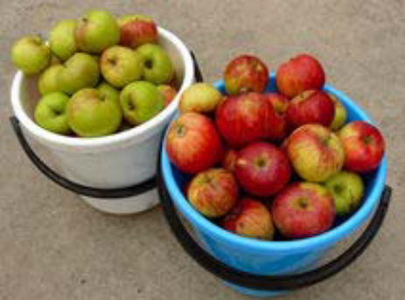

Classification
What is Classification?
Goal: Previously unseen records should be
assigned a class from a given set of classes
as accurately as possible ?
Two ways to do it
Given a collection of records (training set)
  each record contains a set of attributes
  one of the attributes is the class (label) that should be predicted.
Learn a model for the class attribute as a function of the values of other attributes.
Variants:
single-class problems (class labels e.g. true/false or fraud/no fraud)
multi-class problems (class labels e.g. low, medium, high)

Slide 9

Model Learning and Model Application Process

Slide 10
Examples
Credit Risk Assessment
  Attributes: your age, income, debts, …
  Class: Are you getting credit by your bank?
Marketing
  Attributes: previously bought products, browsing behavior
  Class: Are you a target customer for a new product?
Tax Fraud
  Attributes: the values in your tax declaration
  Class: Are you trying to cheat?
SPAM Detection
  Attributes: words and header fields of an e-mail
  Class: Is it a spam e-mail?

Slide 11
Classification Techniques
K-Nearest-Neighbors
Naïve Bayes
Decision Trees
Rule Learning
Support Vector Machines
Artificial Neural Networks
Deep Neural Networks
Many others …

Slide 12
KNN- K Nearest Neighbors
k-Nearest neighbor is an example of instance-based learning, in which the training data set is stored, so that a classification for a new unclassified record may be found simply by comparing it to the most similar records in the training set.
Some pros and cons of KNN
Pros:
No assumptions about underlying data
Simple and effective to explain and understand/interpret
High accuracy (relatively) and fast training phase
Versatile-useful for classification or regression
Cons:
Doesn't produce a model, limiting the ability to understand how the features are related to the class
Computationally expensive-because the algorithm stores all of the training data
High memory requirement
Requires selection of an appropriate k
Sensitive to irrelevant features and the scale of the data
Nominal features and missing data requires additional processing

Slide 13
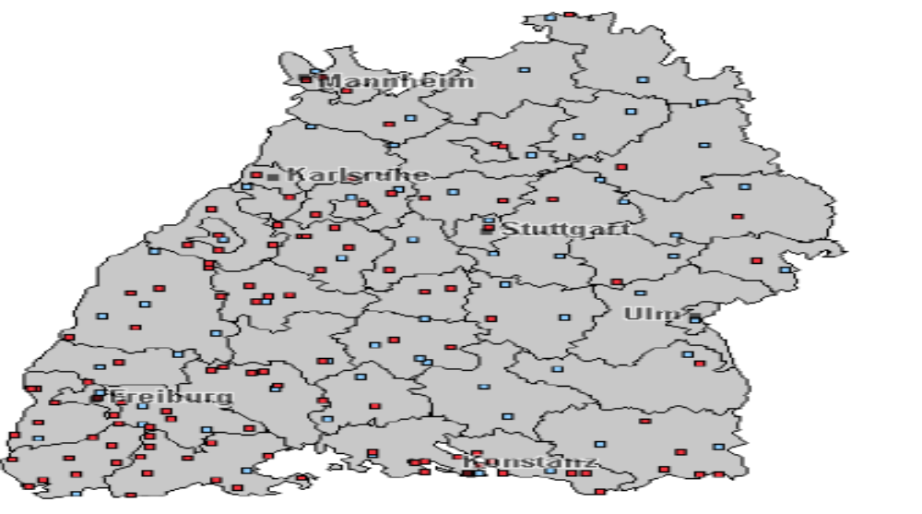
Example -KNN
Predict what is the current weather condition in a place where there is no weather station.
Use the average of the nearest stations?
How many neighbors to consider?
What does “near” means?
x

Slide 14
Example- Two category and one attribute
We have two categories called male and female with their respective heights given in the table below.
Suppose a new member shows up and you are asked to determine if it is a male or female given you already know his/her height, then you can plot that height in 1D plane and the check the proximity of that new height with other already drawn heights. Ideally speaking, we would calculate the Euclidean distance on that graph to determine the closest heights to height of new member.
For example, if the height is 180 cm it is most likely the person is a male.
Sex | M | M | F | F | M | F | M | F
Height(cm) | 178 | 179 | 163 | 168 | 181 | 170 | 184 | 171

Slide 15






Example-KNN
  If it walks like a duck, quacks like a duck, then it’s probably a duck
Compute Distance
Test Record
Training Records
Choose k of the “nearest” records

Slide 16
KNN- Classifiers
In order to use KNN classifier we need three things
The set of stored records
A distance measure to compute distance between records
The value of k, the number of nearest neighbors to consider
To classify the unknown record:
Compute distance to each training record
Identify k-nearest neighbors
Use class labels of nearest neighbors to determine the class label of unknown record
  by taking majority vote or
  by weighing the vote according to distance

Slide 17
Features Of KNN Algorithm
The KNN algorithm has the following features:
KNN is a Supervised Learning algorithm that uses labeled input data set to predict the output of the data points.
It is one of the simplest machine learning algorithms and it can be easily implemented for a varied set of problems.
It is mainly based on feature similarity. KNN checks how similar a data point is to its neighbor and classifies the data point into the class it is most similar to.
Unlike most algorithms, KNN is a non-parametric model which means that it does not make any assumptions about the data set. This makes the algorithm more effective since it can handle realistic data.
KNN is a lazy algorithm, this means that it memorizes the training data set instead of learning a discriminative function from the training data.
KNN can be used for solving both classification and regression problems.

Slide 18
KNN Algorithm
Basic KNN algorithm
Input: Training samples D, Test sample d, K
Output: Class label of test sample
1: Compute the distance between d and every sample in D
2: Choose the K samples in D that are nearest to d; denote the set by P (∈D)
3: Assign d the class it that is the most frequent class (or the majority class)

Slide 19
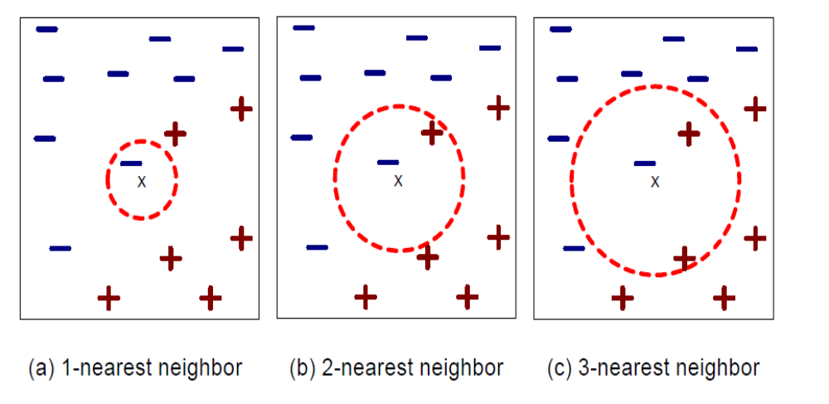
Examples of K-Nearest Neighbors
The k-nearest neighbors of a record x are data points that have the k smallest distances to x.

Slide 20
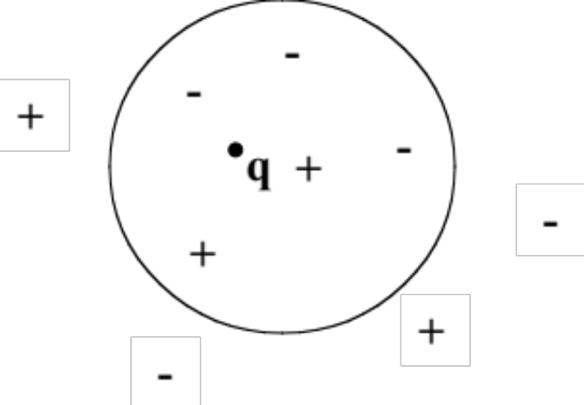
KNN- A Lazy Algorithm
What does “lazy” algorithm mean?
KNN does not use the training data points to do any generalization.
In other words, there is no explicit training phase or it is very minimal. This also means that the training phase is pretty fast . Lack of generalization means that KNN keeps all the training data. To be more exact, all (or most) the training data is needed during the testing phase.
q is + under 1-NN
q is – under 5 –NN
KNN is non-parametric, instance-based and used in a supervised learning setting.

Slide 21
Lazy versus Eager Learning
Lazy Learning
  Instance-based learning approaches, like KNN, are also called lazy learning as no explicit knowledge (model) is learned
  Single goal: Classify unseen records as accurately as possible
Eager Learning
Actually have two goals
1. classify unseen records
2. understand the application domain as a human
Eager learning approaches generate models that are (might be) interpretable by humans
Examples of eager techniques: Logistic regression, Decision Trees Support Vector Machines (SVM), Neural Networs

Slide 22
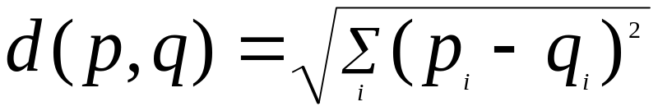

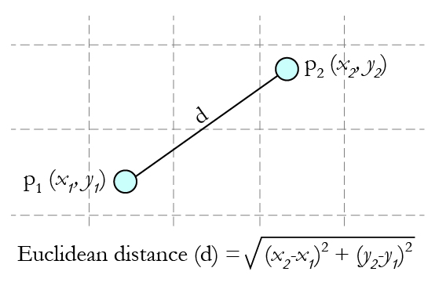
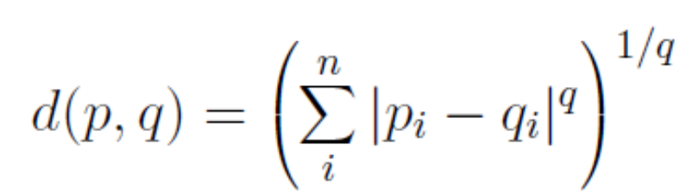
Distance calculation
A distance metric
  Euclidean
  Manhattan distance
  q-norm distance
  When different units are used for each dimension
    normalize each dimension by standard deviation
  For discrete data, can use hamming distance
    D (x1,x2) =number of features on which x1 and x2 differ
    Example: The hamming distance between x1=(01011) and x2=(11010) is 2.
KNN usually use the Euclidean distance

Slide 23
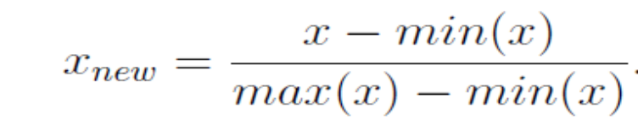
Preparing data for use with k-NN
Features are typically transformed to a standard range prior to applying the k-NN algorithm. The rationale for this step is that the distance formula is highly dependent on how features are measured. In particular, if certain features have a much larger range of values than the others, the distance measurements will be strongly dominated by the features with larger ranges.
The solution is to rescale the features by shrinking or expanding their range such that each one contributes relatively equally to the distance formula.
The traditional method of rescaling features for k-NN is
min-max normalization.
This process transforms a feature such that all of its values fall in a range between 0 and 1

Slide 24
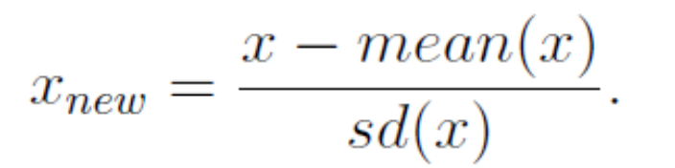
Preparing data for KNN
Another common transformation is called z-score standardization. The following formula subtracts the mean value of feature x, and divides the outcome by the standard deviation of x:
Remark: The Euclidean distance formula is not defined for nominal data.
Therefore, to calculate the distance between nominal features, we need to convert them into a numeric format. A typical solution utilizes dummy coding, where a value of 1 indicates one category, and 0, the other.

Slide 25
Problem with Euclidean measure
High dimensional data
curse of dimensionality
Can produce counter-intuitive results
Normalize the vectors to unit length
1 1 1 1 1 1 1 1 1 1 1 0
1 0 0 0 0 0 0 0 0 0 0 0
vs
0 1 1 1 1 1 1 1 1 1 1 1
0 0 0 0 0 0 0 0 0 0 0 1
d = 1.4142
d = 1.4142

Slide 26
Choosing k
How should we choose the value of k?
In fact, there may not be an obvious best solution.
Choosing small vale of k
It is possible that the classification or estimation may be unduly affected by outliers or unusual observation (“noise”). With small k (e.g., k=1), the algorithm will simply return the target value of the nearest observation, a process that may lead the algorithm toward overfitting, tending to memorize the training data set at the expense of generalizability.
Choosing large value of k
Choosing large value of k will tend to smooth out any distictive behavior learned from the training data. If k is too large, locally interesting behavior will be overlooked.

Slide 27
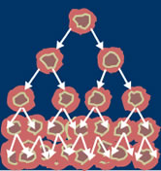
Example
Routine breast cancer screening allows the disease to be diagnosed and treated prior to it causing noticeable symptoms. The process of early detection involves examining the breast tissue for abnormal lumps or masses. If a lump is found, biopsy is performed, which uses a hollow needle to extract a small sample of cells from the mass. A clinician then examines the cells under a microscope to determine whether the mass is likely to be malignant or benign.
data=read.table("C:\\Aryal\\CS59000\\Data\\wdbc.data", sep=",")
names(data)=c("id","diagnosis","radius_mean","texture_mean","perimeter_mean","area_mean", "smoothness_mean","compactness_mean","concavity_mean","concave_points_mean","symmetry_mean",
"fractal_dimension_mean","radius_se","texture_se","perimeter_se","area_se","smoothness_se",
"compactness_se","concavity_se","concave_points_se","symmetry_se","fractal_dimension_se",
"radius_worst","texture_worst","perimeter_worst","area_worst", "smoothness_worst", "compactness_worst", "concavity_worst","concave_points_worst","symmetry_worst", "fractal_dimension_worst")
> attach(data)
> table(diagnosis)
diagnosis
B M
357 212
> round(prop.table(table(diagnosis))*100, digits=1)
diagnosis
B M
62.7 37.3 https://archive.ics.uci.edu/ml/datasets/Breast+Cancer+Wisconsin+(Diagnostic)

Slide 28
Example-Contd.
Transformation-Normalizing numeric data
normalize<-function(x){
return((x-min(x))/(max(x)-min(x)))
}
calculate the normalized values for each variables except the diagnosis.
wbcd=data[-1]
wbcd_n=as.data.frame(lapply(wbcd[2:31],normalize))
summary(wbcd_n)
Create training and test datasets
wbcd_train=wbcd_n[1:469,]
wbcd_test=wbcd_n[470:569,]

Slide 29
Example-Contd.
Note that we have to insert the response variable diagnosis in both the training data and test dataset.
wbcd_train_label=wbcd[1:469,1]
wbcd_test_label=wbcd[470:569,1]
Establishing a model on the data
> library(class)
> wbcd_test_pred=knn(train=wbcd_train,test=wbcd_test, cl=wbcd_train_label, k=21)
> table(wbcd_test_pred)
wbcd_test_pred
B M
79 21

Slide 30
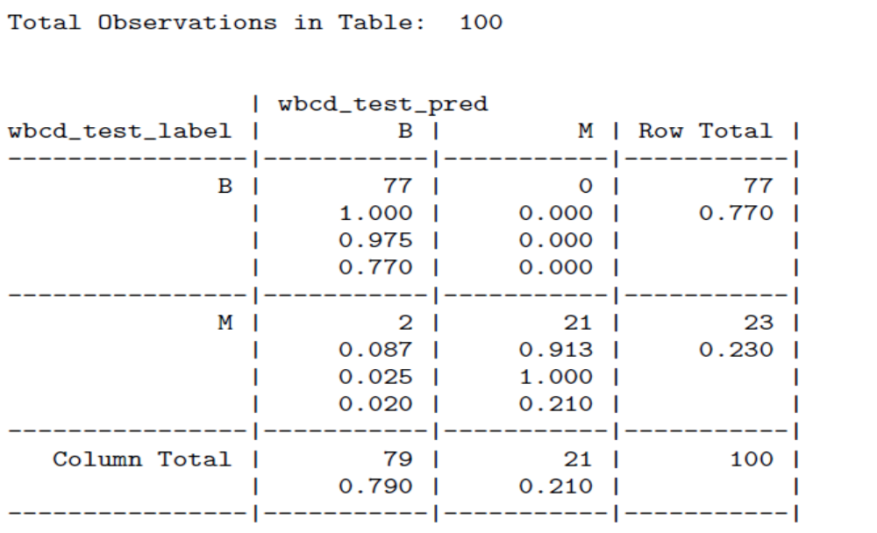
Example-Contd.
Evaluation the model performance (Confusion Matrix)
> library(gmodels)
> CrossTable(x=wbcd_test_label, y=wbcd_test_pred, prop.chisq=FALSE)

Slide 31
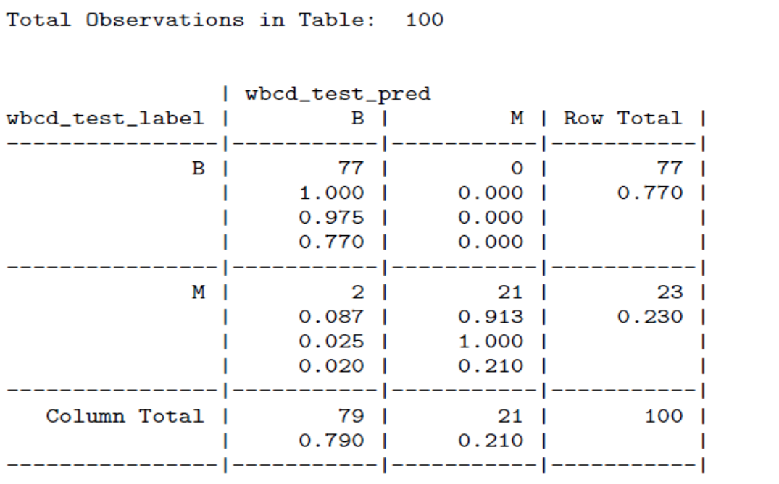
Example- Contd.
These 77 of 100 values are cases where the mass was benign
and the k-NN algorithm correctly identified it as such.
A total of 2 out of 100, or 2 percent of masses were incorrectly classified by the k-NN approach.

Slide 32
Transformation using the Z-score Approach
data=read.table("C:\\Aryal\\CS59000\\Data\\wdbc.data", sep=",")
attach(data)
wbcd=data[-1]
attach(wbcd)
wbcd_z=as.data.frame(scale(wbcd[-1]))
wbcd_train=wbcd_z[1:469,]
wbcd_test=wbcd_z[470:569,]
wbcd_train_label=wbcd[1:469,1]
wbcd_test_label=wbcd[470:569,1]
wbcd_test_pred=knn(train=wbcd_train,test=wbcd_test, cl=wbcd_train_label,k=21)
CrossTable(x=wbcd_test_label,y=wbcd_test_pred, prop.chisq=FALSE)

Slide 33
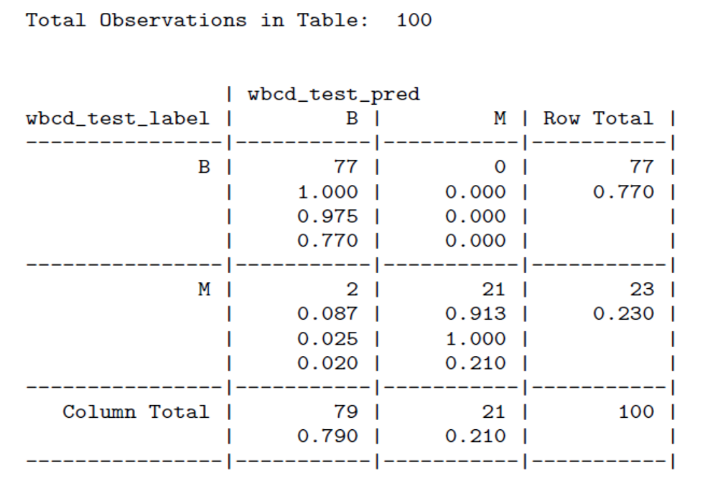
Example-Contd.
We have the same result. Both transformation yield same results.

Slide 34
Using caret package –confusion matrix
> library(caret)
> confusionMatrix(data=factor(wbcd_test_pred),reference=factor(wbcd_test_label),positive = "M")
Reference
Prediction B M
B 77 2
M 0 21
Accuracy : 0.98
95% CI : (0.9296, 0.9976)
No Information Rate : 0.77
P-Value [Acc > NIR] : 2.106e-09
Kappa : 0.9418
Mcnemar's Test P-Value : 0.4795
Sensitivity : 0.9130
Specificity : 1.0000
Pos Pred Value : 1.0000
Neg Pred Value : 0.9747
Prevalence : 0.2300
Detection Rate : 0.2100
Detection Prevalence : 0.2100
Balanced Accuracy : 0.9565
'Positive' Class : M

Slide 35
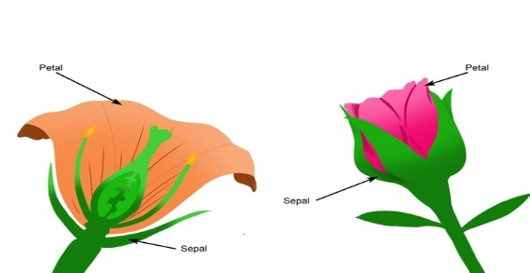
Example 2- Iris data
This is perhaps the best known database to be found in the pattern recognition literature.
This data describes the measurements in centimeters of the variables sepal length and width and petal length and width, respectively, for 50 flowers from each of 3 species of iris. The species are Iris setosa, versicolor, and virginica.
https://archive.ics.uci.edu/ml/datasets/iris
> head(iris)
Sepal.Length Sepal.Width Petal.Length Petal.Width Species
1 5.1 3.5 1.4 0.2 setosa
2 4.9 3.0 1.4 0.2 setosa
3 4.7 3.2 1.3 0.2 setosa
4 4.6 3.1 1.5 0.2 setosa
5 5.0 3.6 1.4 0.2 setosa
6 5.4 3.9 1.7 0.4 setosa

Slide 36
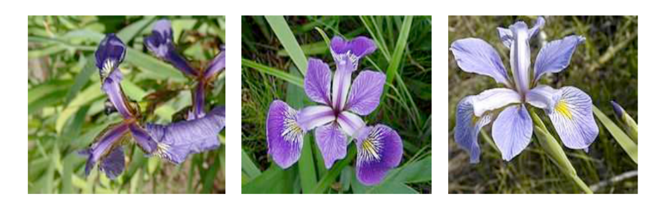
IRIS Flower
Three different species of the Iris data. Iris setosa (Left), Iris versicolor (Middle), and Iris virginica (Right).

Slide 37
Example 2- iris data
data("iris") # load Iris Dataset
str(iris)
We require two sets of data : Training and Testing Data(generally in 80:20 ratio). Since the iris dataset is sorted by “Species” by default, we should use randomly choose training data (approximately 80%) and the rest will be used for testing the model.
set.seed(111) # required to reproduce the results
rnum<- sample(rep(1:150)) # randomly generate numbers from 1 to 150
rnum
Now we can use R code blow to randomize iris data and convert to standard form
iris<- iris[rnum,] #randomize "iris" dataset
normalize <- function(x){
return ((x-min(x))/(max(x)-min(x)))
}
iris_norm<- as.data.frame(lapply(iris[,c(1,2,3,4)],normalize))
head(iris_norm)

Slide 38
Example 2- Contd.
>iris.train<- iris_norm[1:130,]
>iris.train_label<- iris[1:130,5]
>iris.test<- iris_norm[131:150,]
>iris.test_label<- iris[131:150,5]
########################
> model<- knn(train=iris.train, test=iris.test, cl=iris.train_label, k=16)
>table(iris.test_label, model)
model
iris.test_label setosa versicolor virginica
setosa 6 0 0
versicolor 0 7 1
virginica 0 1 5
##############################
> library(gmodels)
> CrossTable(x=iris.test_label,y=model, prop.chisq=FALSE)

Slide 39
Example2-Iris data
| model
iris.test_label | setosa | versicolor | virginica | Row Total |
----------------|------------|------------|------------|------------|
setosa | 6 | 0 | 0 | 6 |
| 1.000 | 0.000 | 0.000 | 0.300 |
| 1.000 | 0.000 | 0.000 | |
| 0.300 | 0.000 | 0.000 | |
----------------|------------|------------|------------|------------|
versicolor | 0 | 7 | 1 | 8 |
| 0.000 | 0.875 | 0.125 | 0.400 |
| 0.000 | 0.875 | 0.167 | |
| 0.000 | 0.350 | 0.050 | |
----------------|------------|------------|------------|------------|
virginica | 0 | 1 | 5 | 6 |
| 0.000 | 0.167 | 0.833 | 0.300 |
| 0.000 | 0.125 | 0.833 | |
| 0.000 | 0.050 | 0.250 | |
----------------|------------|------------|------------|------------|
Column Total | 6 | 8 | 6 | 20 |
| 0.300 | 0.400 | 0.300 | |
----------------|------------|------------|------------|------------|

Slide 40
Example2-Iris data
>library(caret)
>confusionMatrix(data=factor(model),reference=factor(iris.test_label))
Also check
> model<- knn(train=iris.train, test=iris.test, cl=iris.train_label, prob = TRUE, k=16)
> attributes(model)$prob

Slide 41
Calculating and plotting the k-Nearest Neighbor Distance
> library(dbscan)
> data(iris)
> iris <- as.matrix(iris[,1:4])
> kNNdist(iris, k=4, all = TRUE) # produces distance between #first four neighbors
> kNNdistplot(iris, k=4) # Look for a knee to determine eps
# for DBSCAN clustering
> cl <- dbscan(iris, eps = .5, minPts = 4)
> pairs(iris, col = cl$cluster+1L)
## black are noise points

Slide 42
Choosing K value
library(class)
data(iris)
set.seed(111) # required to reproduce the results
rnum<- sample(rep(1:150))
iris_norm<- as.data.frame(lapply(iris[,c(1,2,3,4)],scale))
head(iris_norm)
iris.train<- iris_norm[1:130,]
iris.train_label<- iris[1:130,5]
iris.test<- iris_norm[131:150,]
iris.test_label<- iris[131:150,5]
i=1
k.optm=1
for (i in 1:15){
knn.mod <- knn(train=iris.train, test=iris.test, cl=iris.train_label, k=i)
k.optm[i] <- 100 * sum(iris.test_label == knn.mod)/NROW(iris.test_label)
cat(i,'=',k.optm[i],'\n')
}

Slide 43
Which is best model for the given dataset?
y
y
x
x
Why not choose the method with the best fit to the data?

Slide 44
What do we really want?
y
y
x
x
Why not choose the method with the best fit to the data?
“How well are you going to predict future data drawn from the same distribution?”

Slide 45
The test set method
1. Randomly choose 30% of the data to be in a test set
2. The remainder is a training set
y
x

Slide 46
The test set method
1. Randomly choose 30% of the data to be in a test set
2. The remainder is a training set
3. Perform your regression on the training set
y
x
(Linear regression example)

Slide 47
The test set method
1. Randomly choose 30% of the data to be in a test set
2. The remainder is a training set
3. Perform your regression on the training set
4. Estimate your future performance with the test set
y
x
(Linear regression example)
Mean Squared Error = 2.4

Slide 48
The test set method
1. Randomly choose 30% of the data to be in a test set
2. The remainder is a training set
3. Perform your regression on the training set
4. Estimate your future performance with the test set
y
x
(Quadratic regression example)
Mean Squared Error = 0.9

Slide 49
The test set method
1. Randomly choose 30% of the data to be in a test set
2. The remainder is a training set
3. Perform your regression on the training set
4. Estimate your future performance with the test set
y
x
(Join the dots example)
Mean Squared Error = 2.2

Slide 50
The test set method
Good news:
Very very simple
Can then simply choose the method with the best test-set score
Bad news:
Wastes data: we get an estimate of the best method to apply to 30% less data
If we don’t have much data, our test-set might just be lucky or unlucky
We say the “test-set estimator of performance has high variance”

Slide 51
LOOCV (Leave-one-out Cross Validation)
For k=1 to n
  1. Let (x_{k},y_{k}) be the k^{th} record
y
x

Slide 52
LOOCV (Leave-one-out Cross Validation)
For k=1 to n
  1. Let (x_{k},y_{k}) be the k^{th} record
  2. Temporarily remove (x_{k},y_{k}) from the dataset
y
x

Slide 53
LOOCV (Leave-one-out Cross Validation)
For k=1 to R
  1. Let (x_{k},y_{k}) be the k^{th} record
  2. Temporarily remove (x_{k},y_{k}) from the dataset
  3. Train on the remaining n-1 datapoints
y
x

Slide 54
LOOCV (Leave-one-out Cross Validation)
For k=1 to n
  1. Let (x_{k},y_{k}) be the k^{th} record
  2. Temporarily remove (x_{k},y_{k}) from the dataset
  3. Train on the remaining n-1 datapoints
  4. Note your error (x_{k},y_{k})
y
x

Slide 55
LOOCV (Leave-one-out Cross Validation)
For k=1 to n
  1. Let (x_{k},y_{k}) be the k^{th} record
  2. Temporarily remove (x_{k},y_{k}) from the dataset
  3. Train on the remaining n-1 datapoints
  4. Note your error (x_{k},y_{k})
When you’ve done all points, report the mean error.
y
x

Slide 56
LOOCV (Leave-one-out Cross Validation)
For k=1 to n
  1. Let (x_{k},y_{k}) be the k^{th} record
  2. Temporarily remove (x_{k},y_{k}) from the dataset
  3. Train on the remaining n-1 datapoints
  4. Note your error (x_{k},y_{k})
When you’ve done all points, report the mean error.
y
y
y
x
x
x
y
y
y
x
x
x
MSE_{LOOCV} = 2.12
y
y
y
x
x
x

Slide 57
LOOCV for Quadratic Regression
For k=1 to n
  1. Let (x_{k},y_{k}) be the k^{th} record
  2. Temporarily remove (x_{k},y_{k}) from the dataset
  3. Train on the remaining n-1 datapoints
  4. Note your error (x_{k},y_{k})
When you’ve done all points, report the mean error.
y
y
y
x
x
x
y
y
y
x
x
x
MSE_{LOOCV}=0.962
y
y
y
x
x
x

Slide 58
LOOCV for Join The Dots
For k=1 to n
  1. Let (x_{k},y_{k}) be the k^{th} record
  2. Temporarily remove (x_{k},y_{k}) from the dataset
  3. Train on the remaining n-1 datapoints
  4. Note your error (x_{k},y_{k})
When you’ve done all points, report the mean error.
y
y
y
x
x
x
y
y
y
x
x
x
y
y
y
MSE_{LOOCV}=3.33
x
x
x

Slide 59
Which kind of Cross Validation?
 | Downside | goodside
Test-set | Variance: unreliable estimate of future performance | Cheap
Leave-one-out | Expensive. Has some weird behavior | Doesn’t waste data
..can we get the best of both worlds?

Slide 60
k-fold Cross Validation
Randomly break the dataset into k partitions (in our example we’ll have k=3 partitions colored Red Green and Blue)
y
x

Slide 61
k-fold Cross Validation
Randomly break the dataset into k partitions (in our example we’ll have k=3 partitions colored Red Green and Blue)
  For the red partition: Train on all the points not in the red partition. Find the test-set sum of errors on the red points.
y
x

Slide 62
k-fold Cross Validation
Randomly break the dataset into k partitions (in our example we’ll have k=3 partitions colored Red Green and Blue)
  For the red partition: Train on all the points not in the red partition. Find the test-set sum of errors on the red points.
  For the green partition: Train on all the points not in the green partition. Find the test-set sum of errors on the green points.
y
x

Slide 63
k-fold Cross Validation
Randomly break the dataset into k partitions (in our example we’ll have k=3 partitions colored Red Green and Blue)
  For the red partition: Train on all the points not in the red partition. Find the test-set sum of errors on the red points.
  For the green partition: Train on all the points not in the green partition. Find the test-set sum of errors on the green points.
  For the blue partition: Train on all the points not in the blue partition. Find the test-set sum of errors on the blue points.
y
x

Slide 64
k-fold Cross Validation
Randomly break the dataset into k partitions (in our example we’ll have k=3 partitions colored Red Green and Blue)
  For the red partition: Train on all the points not in the red partition. Find the test-set sum of errors on the red points.
  For the green partition: Train on all the points not in the green partition. Find the test-set sum of errors on the green points.
  For the blue partition: Train on all the points not in the blue partition. Find the test-set sum of errors on the blue points.
  Then report the mean error
y
x
Linear Regression MSE_{3FOLD}=2.05

Slide 65
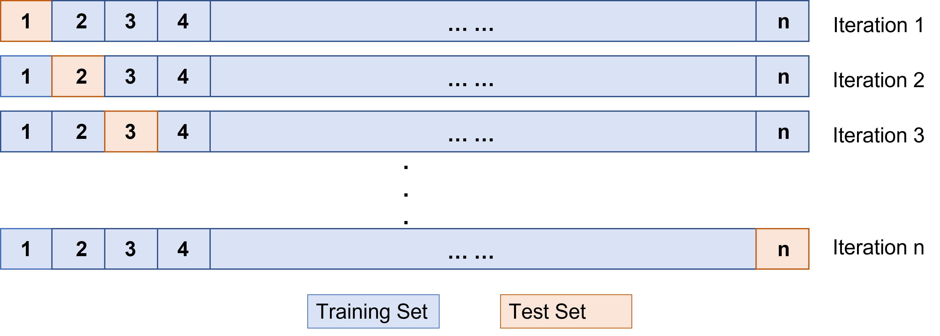
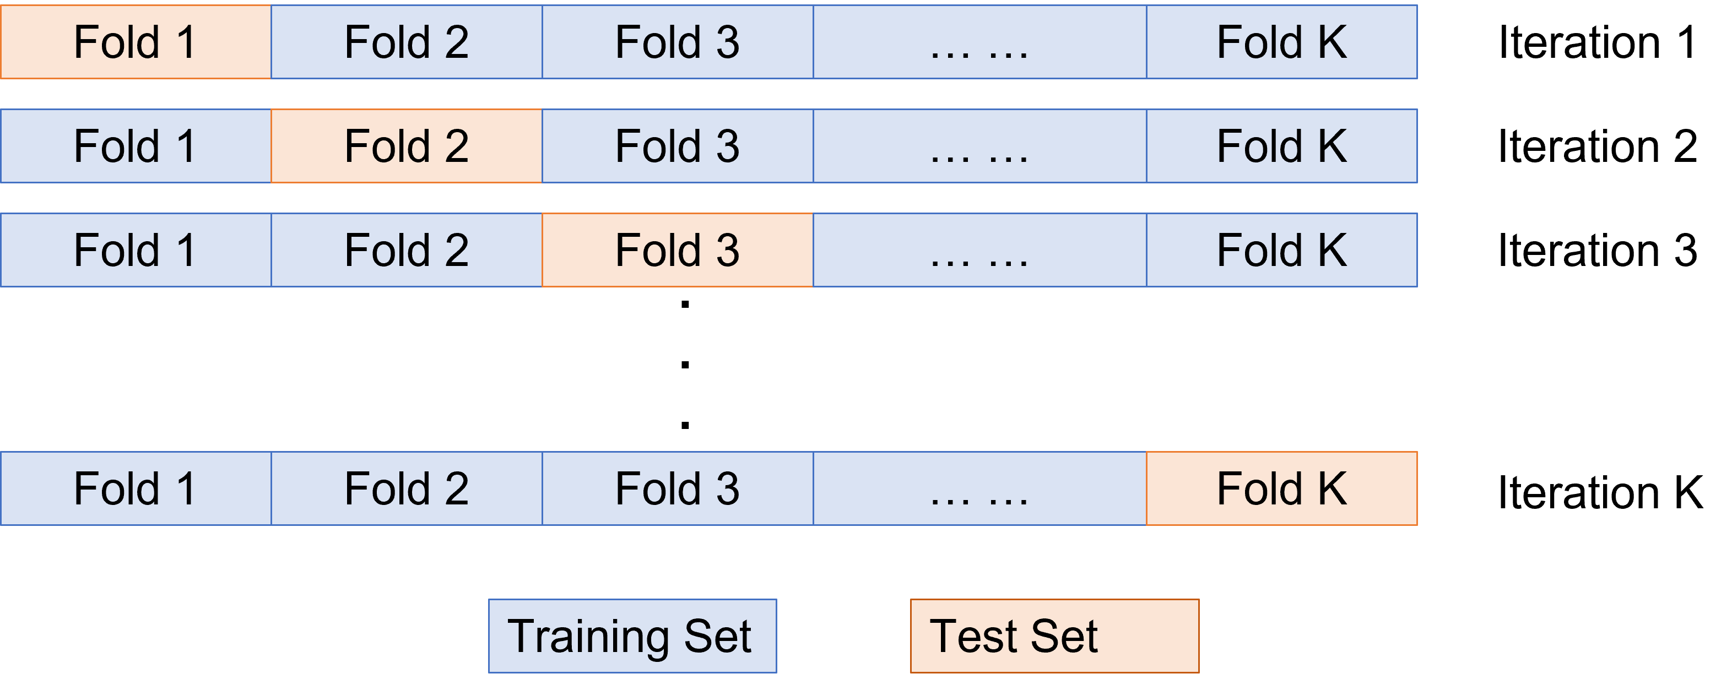
LOOCV Vs. k-fold validation

Slide 66
cross-validation using R
library(ggplot2)
library(e1071)
library(caret)
data(iris)
attach(iris)
train.index.vsa <- createDataPartition(iris$Species, p= 0.8, list = FALSE)
train.vsa <- iris[train.index.vsa,]
test.vsa <- iris[-train.index.vsa,]
role = rep('train',nrow(iris))
role[-train.index.vsa] = 'test’
ggplot(data = cbind(iris,role))
+ geom_point(aes(x = Sepal.Length, y = Petal.Width, color = role))
model.vsa <- lm(Petal.Width ~., data = train.vsa)
### Testing
predictions.vsa <- predict(model.vsa,data.frame(test.vsa))
### Evaluating
data.frame(RMSE = RMSE(predictions.vsa, test.vsa$Petal.Width), R2 = R2(predictions.vsa, test.vsa$Petal.Width),
MAE = MAE(predictions.vsa, test.vsa$Petal.Width))
train.loocv <- trainControl(method = "LOOCV")
model.loocv <- train(Petal.Width ~.,data = iris, method = "lm", trControl = train.loocv)
print(model.loocv)

Slide 67
Loocv and k-fold validation in R
data(iris)
attach(iris)
train.loocv <- trainControl(method = "LOOCV")
model.loocv <- train(Petal.Width ~.,data = iris, method = "lm", trControl = train.loocv)
print(model.loocv)
################################################
train.kfold <- trainControl(method = "cv", number = 5)
model.kfold <- train(Petal.Width ~., data = iris,method = "lm", trControl = train.kfold)
print(model.kfold)

Slide 68
Searching for optimal k
data("iris")
library(e1071)
library(caret)
dataset <- na.omit(iris)
dataset[,-5] <- scale(dataset[,-5])
validationIndex <- createDataPartition(dataset$Species, p=0.70, list=FALSE)
train <- dataset[validationIndex,] # 70% of data to training
test <- dataset[-validationIndex,] # remaining 30% for test
trainControl <- trainControl(method="repeatedcv", number=10, repeats=3)
metric <- "Accuracy“
fit.knn <- train(Species~., data=train, method="knn", metric=metric,trControl=trainControl)
knn.k1 <- fit.knn$bestTune # keep this Initial k for testing
print(fit.knn)
fit.knn
plot(fit.knn)
# Grid search
grid <- expand.grid(.k=seq(1,20,by=1))
fit.knn <- train(Species~., data=train, method="knn", metric=metric, tuneGrid=grid, trControl=trainControl)
knn.k2 <- fit.knn$bestTune
print(fit.knn)
plot(fit.knn)

Slide 69
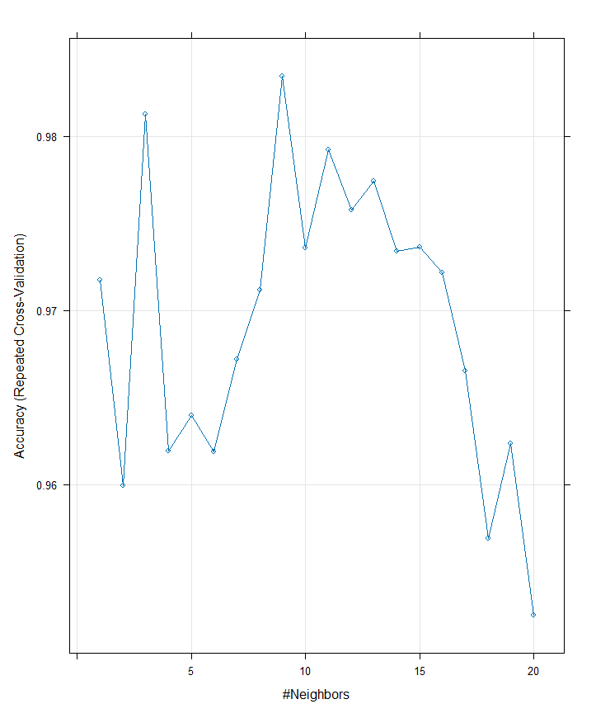
Searching for optimal value of k

Slide 70
Searching for optimal k value
library(class)
library(e1071)
library(caret)
data("iris")
dataset <- na.omit(iris)
dataset[,-5] <- scale(dataset[,-5])
validationIndex <- createDataPartition(dataset$Species, p=0.70, list=FALSE)
train <- dataset[validationIndex,] # 70% of data to training
test <- dataset[-validationIndex,] # remaining 30% for test
i=1
k.optm=1
for (i in 1:15){ knn.mod <- knn(train=train[,-5], test=test[,-5], cl=train[,5], k=i)
k.optm[i] <- 100 * sum(test[,5] == knn.mod)/NROW(test[,5])
cat(i,"=",k.optm[i],"\n")
}
plot(k.optm, type="b", xlab = "k Value", ylab="Accuracy")

Slide 71
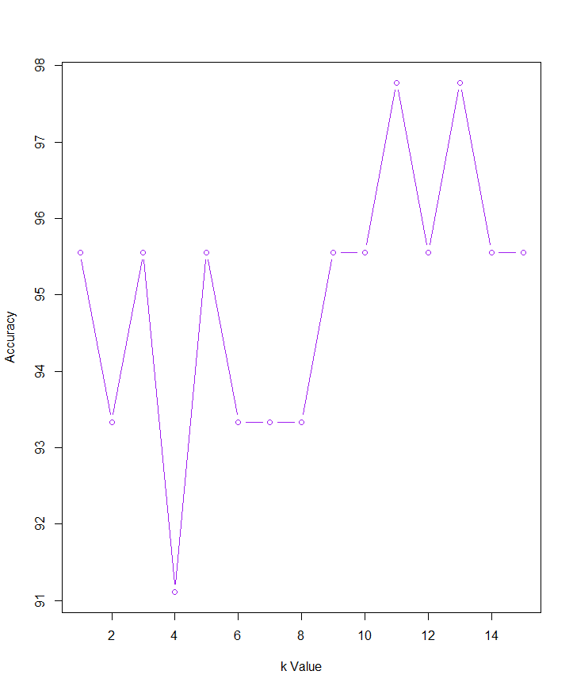
Finding optimal k value

Slide 72
References
Introduction to Data Mining
Pang-Ning Tan, Michael Steinbach,
Anuj Karpatne and Vipin Kumar
An overview of Machine Learning
-Yi-Fan Change
Cross-validation for detecting and preventing overfitting
-Andrew W. Moore

Slide 73
Thank you

